Slide 1
Unit 4
Neural Network

Slide 2
Contents
Introduction
Biological Neural Networks
Perceptron, Multilayer and Recursive Nets
Gradient Descent
Back Propagation

Slide 3
Introduction
Machine Learning involves adaptive mechanism that enable computer to learn from experience, example and analogy
Learning capability improves performance of an Artificial System over time
Machine learning mechanisms form the basis for adaptive systems
The most popular approaches to machine learning are Artificial Neural Network (ANN) and Genetic Algorithms(GA)
Two types of Machine Learning :
Supervised Learning and
Unsupervised learning

Slide 4
Biological Neural Networks
A neural network can be defined as a model of reasoning based on the human brain. The brain consists of a densely interconnected set of nerve cells, or basic information-processing units, called neurons
Neural networks represent a brain metaphor for information processing. Neural computing refers to a pattern recognition methodology for machine learning. The resulting model from neural computing is often called an artificial neural network (ANN) or neural network (NN).
The human brain incorporates nearly 10 billion neurons and 60 trillion connections, synapses, between them. By using multiple neurons simultaneously, the brain can perform its functions much faster than the fastest computers in existence today.

Slide 5
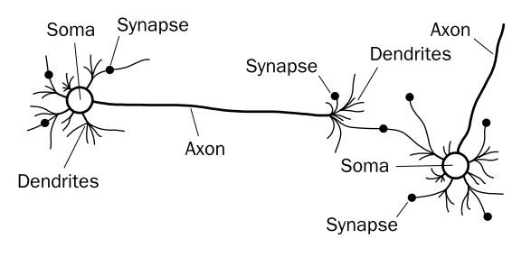
Biological Neural Networks
Each neuron has a very simple structure, but an army of such elements constitutes a tremendous processing power
Neural network elements
Neuron: fundamental functional unit of all nervous system tissue. The central processing portion of a neuron
Soma: cell body, contain nucleus The main body of the neuron in which the cell nucleus is contained
Dendrites: a number of fibres, input The part of a biological neuron that provides inputs to the cell
Axon: single long fibre with many branches, output An outgoing connection (i.e., terminal) from a biological neuron
Synapse: junction of dendrites and axon, each neuron form synapse with 10 to 100000 other neurons The connection (where the weights are) between processing elements in a neural network

Slide 6
Biological Neural Network
HOW DOES BRAIN WORKS
Signals are propagated from neuron to neuron by electrochemical reaction:
Chemical substances are released from the synapses and enter the dendrite, raising or lowering the electrical potential of the cell body
When a potential reaches a threshold, an electrical pulse or action potential is sent down the axon
The pulse spreads out along the branches of the axon, eventually reaching synapses and releasing transmitters into the bodies of other cells
Excitory Synapses: Increase potential
Inhibitory Synapses : Decreases potential

Slide 7
Artificial Neural Network
An ANN model emulates a biological neural network.
Neural concepts are usually implemented as software simulations of the massive parallel processes that involve processing elements (also called artificial neurons) interconnected in a network structure.
Connections between neurons have an associated weight.
Each neuron calculates a weighted sum of the incoming neuron values, transforms this input, and passes on its neural value as the input to subsequent neurons or external outputs.

Slide 8
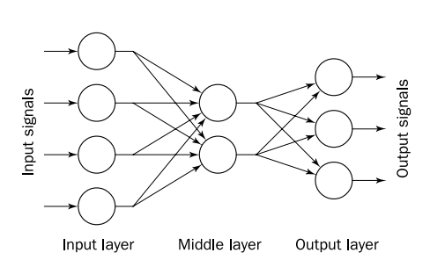
Artificial Neural Network (ANN)
Consists of a number of very simple and highly interconnected processors called neurons
The neurons are connected by weighted links passing signals from one neuron to another.
The output signal is transmitted through the neuron’s outgoing connection. The outgoing connection splits into a number of branches that transmit the same signal. The outgoing ranches terminate at the incoming connections of other neurons in the network

Slide 9
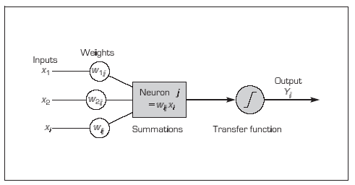
Processing Information in an Artificial Neuron

Slide 10
Analogy Between Biological and ANN
Biological Neural Network | Artificial Neural Network
Soma | Neuron
Dendrite | Input
Axon | Output
Synapse | Weight

Slide 11
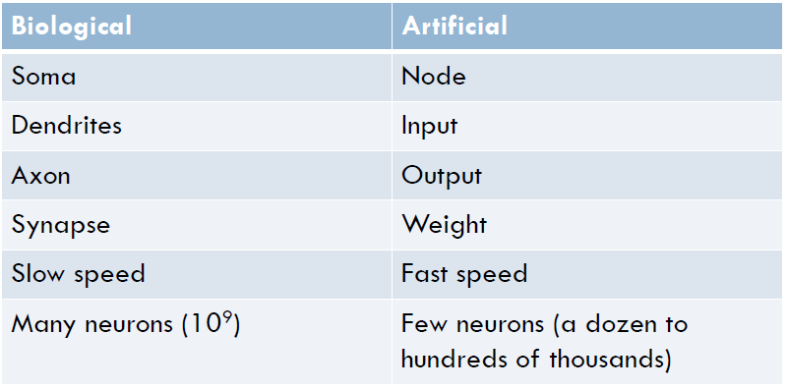
The Relationship Between Biological and Artificial Neural Networks

Slide 12
Learning in ANN
Supervised learning
Uses a set of inputs for which the desired outputs are known
Example: Back propagation algorithm
Unsupervised learning
Uses a set of inputs for which no desired output are known.
The system is self-organizing; that is, it organizes itself internally. A human must examine the final categories to assign meaning and determine the usefulness of the results.
Example: Self-organizing map

Slide 13
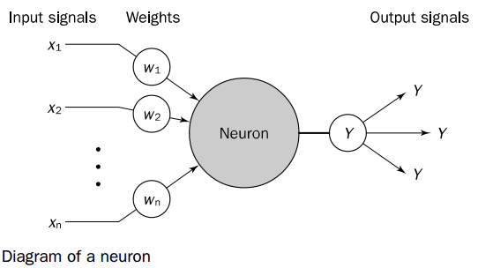
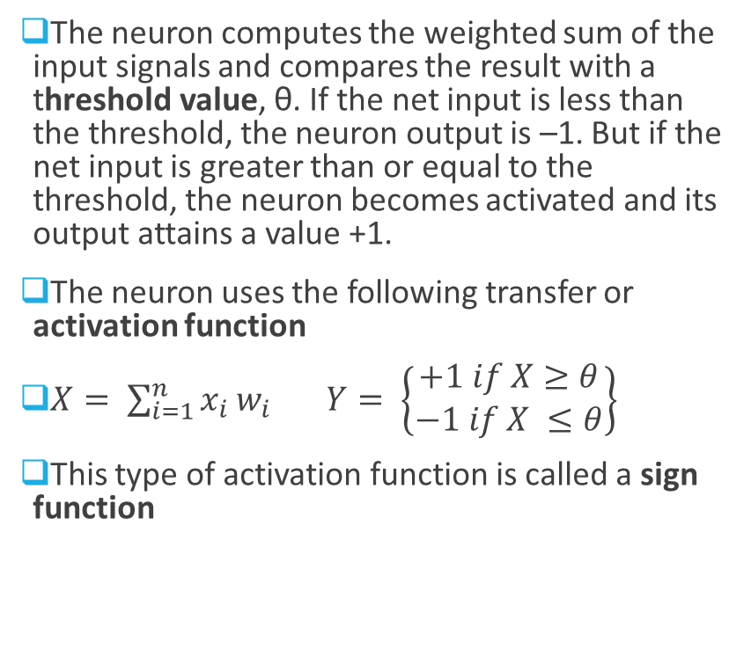
The Neuron as a simple computing element: Diagram of a neuron
The neuron computes the weighted sum of the input signals and compares the result with a threshold value, θ. If the net input is less than the threshold, the neuron output is –1. But if the net input is greater than or equal to the threshold, the neuron becomes activated and its output attains a value +1.
The neuron uses the following transfer or activation function
$X= \sum_{i=1}^{n}{x_{i}}w_{i}$ $Y= \left\{\begin{matrix}+1 if X≥θ \\ −1 if X ≤θ\end{matrix}\right\}$
This type of activation function is called a sign function

Slide 14
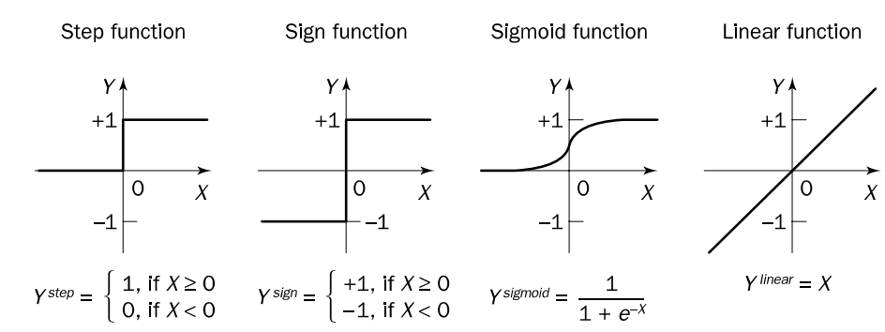
Activation Functions for Neuron

Slide 15
Perceptron
In 1958, Frank Rosenblatt introduced a training algorithm that provided the first procedure for training a simple ANN : a perceptron
The perceptron is the simplest form of a neural network. It consists of a single neuron with adjustable synaptic weights and a hard limiter
The operation of Rosenblatt’s perceptron is based on the McCulloch and Pitts neuron model. The model consists of a linear combiner followed by a hard limiter
The weighted sum of the inputs is applied to the hard limiter, which produces an output equal to +1 if its input is positive and -1 if its input is negative

Slide 16
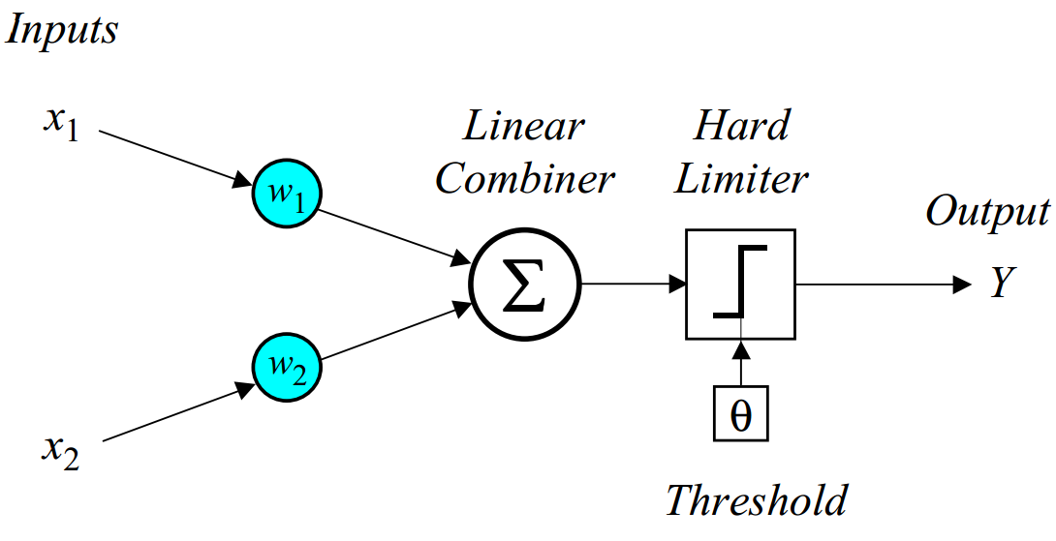
Perceptron
Fig: Single Layer two input Perceptron

Slide 17
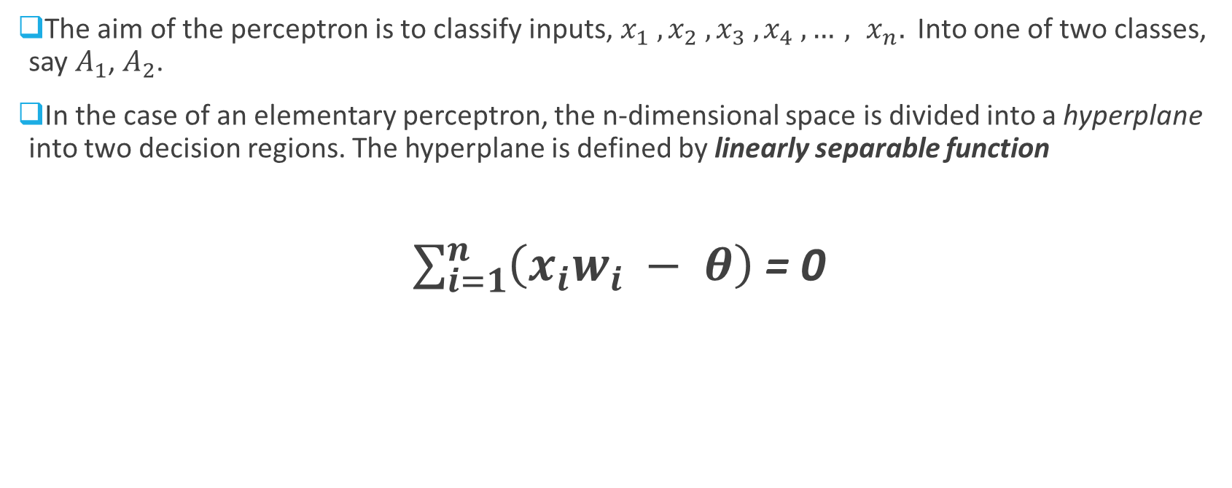
Perceptron
The aim of the perceptron is to classify inputs, $x_{1} , x_{2} , x_{3} ,x_{4} ,…, x_{n}.$ Into one of two classes, say $A_{1}$, $A_{2}$.
In the case of an elementary perceptron, the n-dimensional space is divided into a hyperplane into two decision regions. The hyperplane is defined by linearly separable function
$\sum_{i=1}^{n}{\left(x_{i}w_{i} − θ\right)}$ = 0

Slide 18
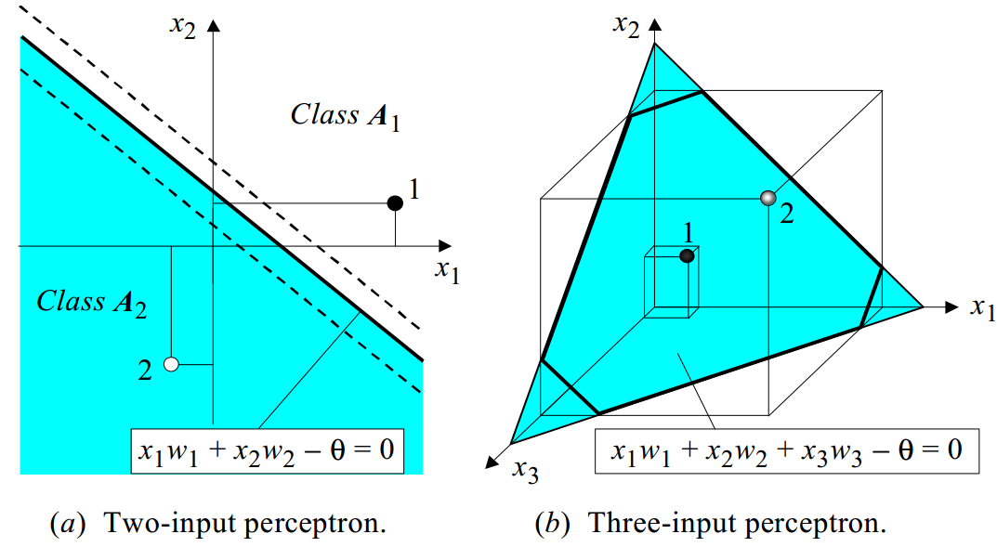
Perceptron
Fig: Linear Separability in the perceptron

Slide 19
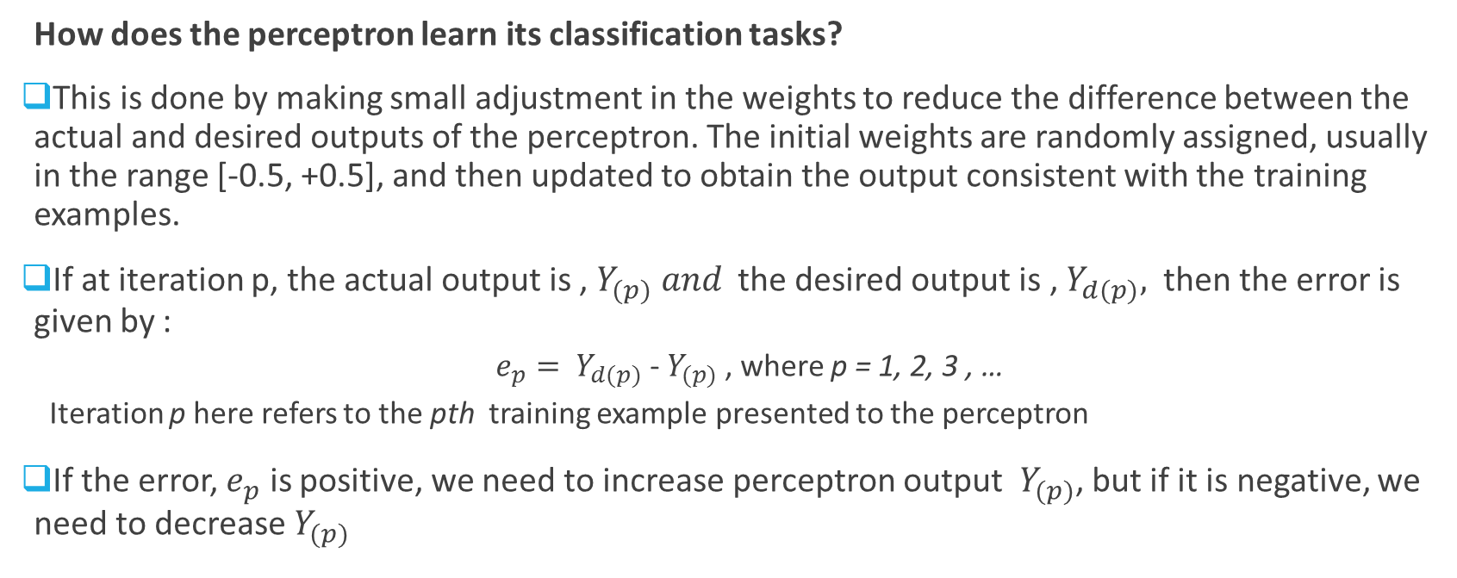
Perceptron
How does the perceptron learn its classification tasks?
This is done by making small adjustment in the weights to reduce the difference between the actual and desired outputs of the perceptron. The initial weights are randomly assigned, usually in the range [-0.5, +0.5], and then updated to obtain the output consistent with the training examples.
If at iteration p, the actual output is , $Y_{(p)} and$ the desired output is , $Y_{d(p)},$ then the error is given by :
$e_{p}= Y_{d(p)}$ - $Y_{(p)}$ , where p = 1, 2, 3 , …
Iteration p here refers to the pth training example presented to the perceptron
If the error, $e_{p}$ is positive, we need to increase perceptron output $Y_{(p)}$, but if it is negative, we need to decrease $Y_{(p)}$

Slide 20
Perceptron
Perceptron Learning Rule
where p = 1, 2, 3, …
α is the learning rate , a positive constant less than unity
The perceptron learning rule was first proposed by Rosenblatt in 1960. Using this rule we can derive perceptron training algorithm for classification task

Slide 21
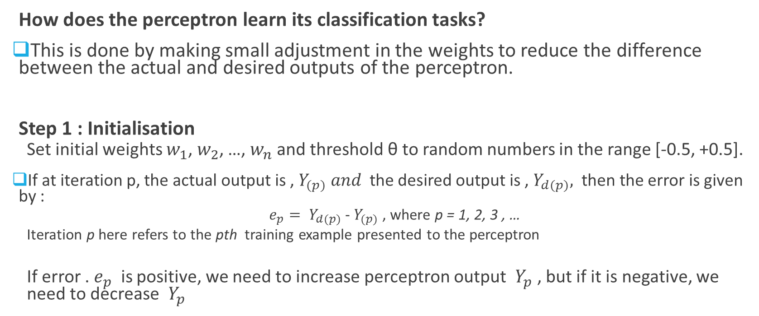
Perceptron training algorithm
How does the perceptron learn its classification tasks?
This is done by making small adjustment in the weights to reduce the difference between the actual and desired outputs of the perceptron.
Step 1 : Initialisation
Set initial weights $w_{1}$, $w_{2}$, …, $w_{n}$ and threshold θ to random numbers in the range [-0.5, +0.5].
If at iteration p, the actual output is , $Y_{(p)} and$ the desired output is , $Y_{d(p)},$ then the error is given by :
$e_{p}= Y_{d(p)}$ - $Y_{(p)}$ , where p = 1, 2, 3 , …
Iteration p here refers to the pth training example presented to the perceptron
If error . $e_{p}$ is positive, we need to increase perceptron output $Y_{p}$ , but if it is negative, we need to decrease $Y_{p}$

Slide 22
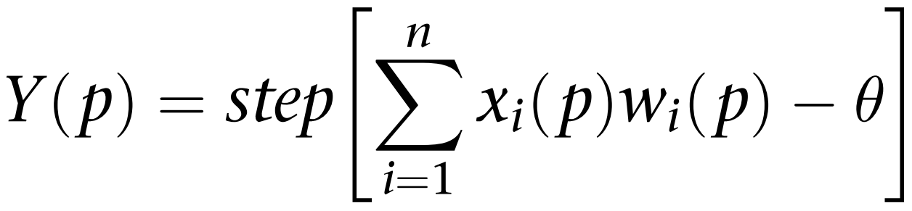
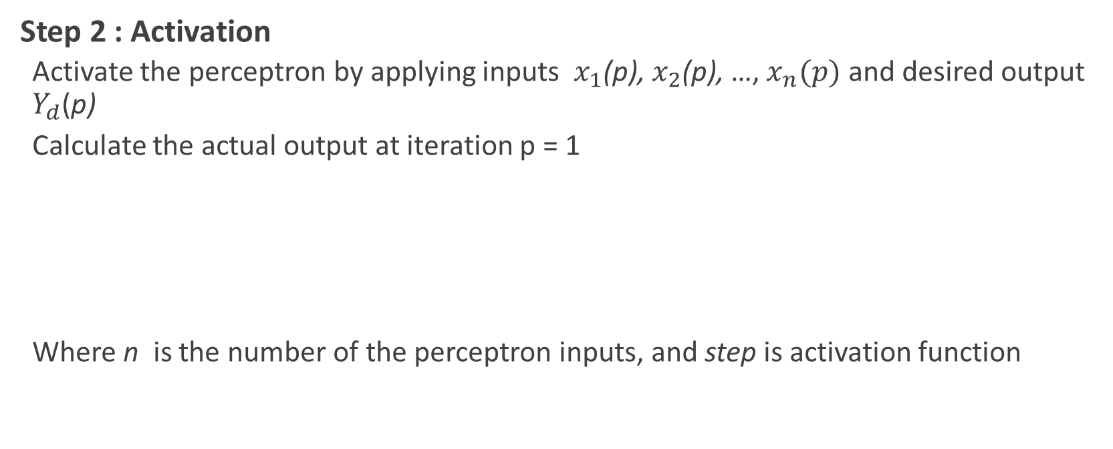
Perceptron training algorithm (contd…)
Step 2 : Activation
Activate the perceptron by applying inputs $x_{1}$(p), $x_{2}$(p), …, $x_{n}(p)$ and desired output $Y_{d}$(p)
Calculate the actual output at iteration p = 1
Where n is the number of the perceptron inputs, and step is activation function

Slide 23
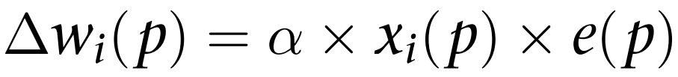
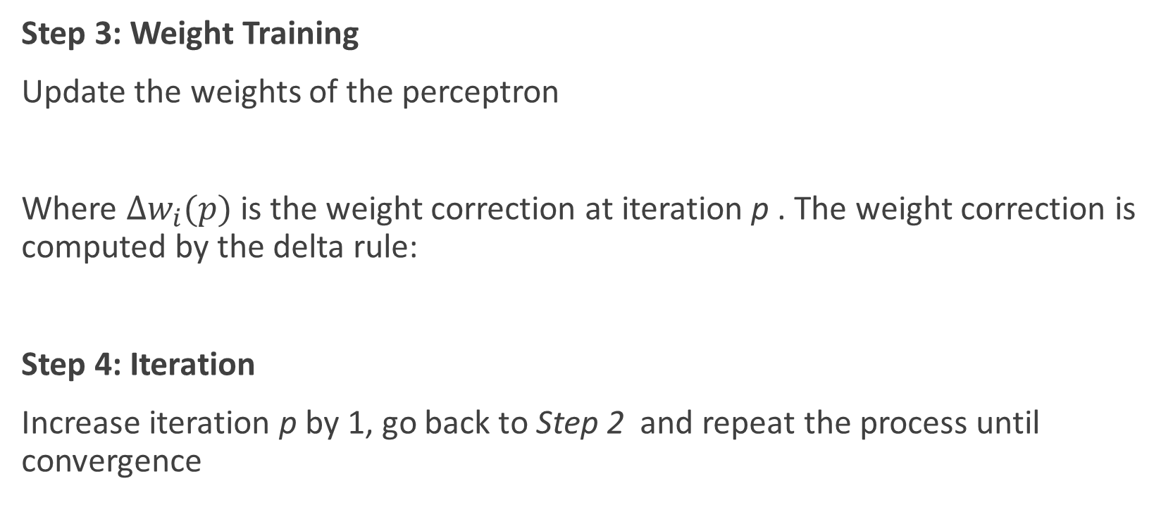
Perceptron training algorithm (contd…)
Step 3: Weight Training
Update the weights of the perceptron
Where $∆w_{i}(p)$ is the weight correction at iteration p . The weight correction is computed by the delta rule:
Step 4: Iteration
Increase iteration p by 1, go back to Step 2 and repeat the process until convergence

Slide 24
Perceptron Training Algorithm
Let’s realize AND operation in simple Perceptron.
x2 = x2 = 1
w1= 0.2, w2 = -0.1
Θ = 0.2, α = 0.1
Solution ???

Slide 25
Multilayer Neural Network
A multi layer perceptron is a feed forward neural network with one or more hidden layers
The network consists of :
Input Layer
Hidden Layer
Output Layer
The input signal is propagated in a forward direction in a layer-by-layer basis

Slide 26
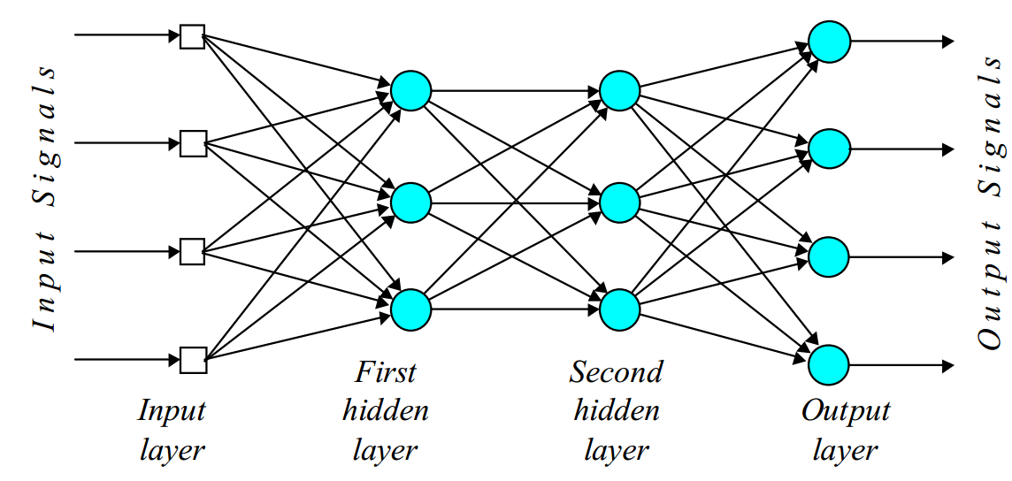
Multilayer Neural Network
Fig: A multilayer Perceptron with two hidden layers

Slide 27
Multilayer Neural Network
The hidden layer “hides” its desired output. Neurons in the hidden layer can not be observed through the input/output behavior of the network. There is no obvious way to know what the desired output of the hidden layer should be.
Commercial ANNs incorporate three and sometimes four layers, including one or two hidden layers. Each layer can contain from 10 to 1000 neurons. Experimental neural networks may have fie or six layers, including three or four hidden layers, and utilise millions of neurons.

Slide 28
Multi-Layer Perceptron
One architecture of NNs is a multi-layer perceptron
The input layer introduces input values into the network ready for processing. No actual processing takes place at this stage.
The hidden layer(s) contains adjustable weights providing links between processors (neurons).Varying the weights will affect the accuracy of the decision-making performed by the system. The aim of human or computer training is to assign correct weights to each connections so that the NN makes correct decisions.
The output layer passes the output from the network to the outside world, normally via the explanatory interface.

Slide 29
Back Propagation
Learning in a multilayer network proceeds the same way as for a perceptron
A training set of input patterns is presented to the network
The network computes its output pattern, and if there is an error –or other word difference between actual and desired output pattern – the weight are adjusted to reduce the error
In a back-propagation neural network, the learning algorithm has two phases
First, a training input pattern is presented to the network input layer. The network propagates the input pattern from layer to layer until the output pattern is generated by the out layer
If this pattern is different from the desired output, an error is calculated and then propagated backwards through the network from the output layer to the input layer. The weights are modified as the error is propagated

Slide 30
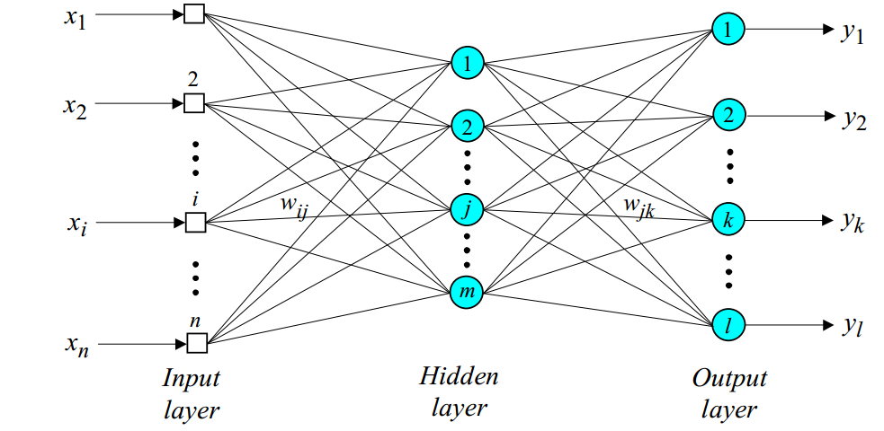
Back Propagation
Input Signals
error signals

Slide 31
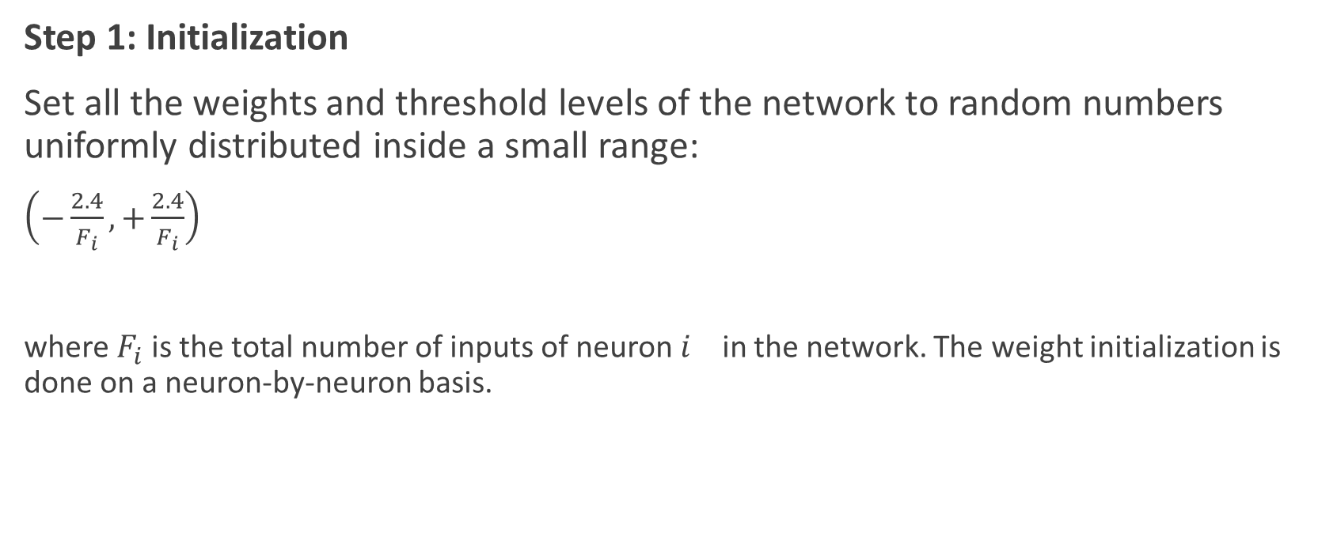
Back Propagation Training Algorithm
Step 1: Initialization
Set all the weights and threshold levels of the network to random numbers uniformly distributed inside a small range:
$\left(−\frac{2.4}{F_{i}}, +\frac{2.4}{F_{i}}\right)$
where $F_{i}$is the total number of inputs of neuron $i_{}$ in the network. The weight initialization is done on a neuron-by-neuron basis.

Slide 32

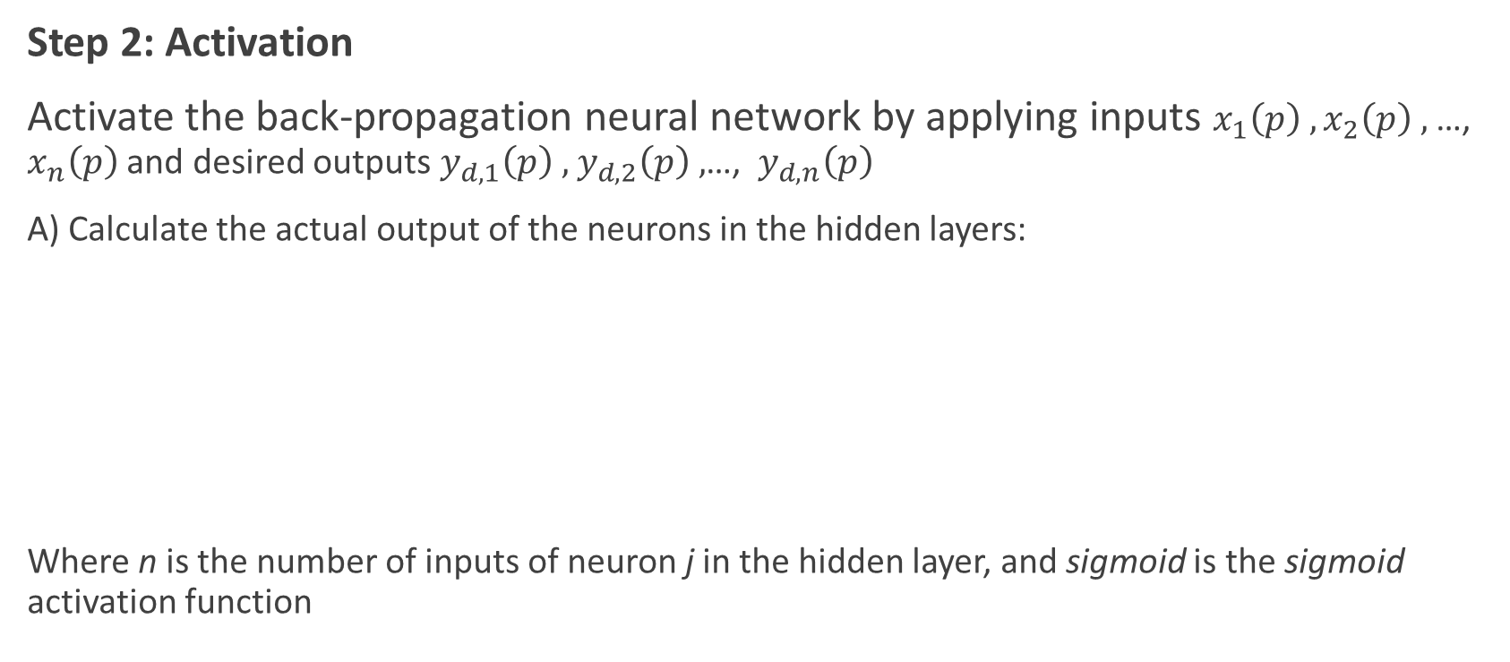
Back Propagation Training Algorithm
Step 2: Activation
Activate the back-propagation neural network by applying inputs $x_{1}\left(p\right) , x_{2}\left(p\right) ,$ …, $x_{n}\left(p\right)$ and desired outputs $y_{d,1}\left(p\right) ,$ $y_{d,2}\left(p\right) ,$…, $y_{d,n}\left(p\right)$
A) Calculate the actual output of the neurons in the hidden layers:
Where n is the number of inputs of neuron j in the hidden layer, and sigmoid is the sigmoid activation function

Slide 33
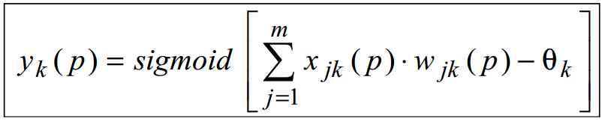
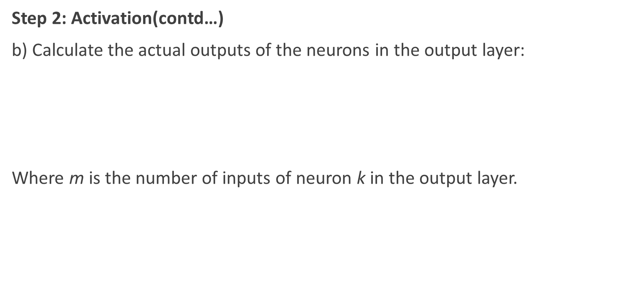
Back Propagation Training Algorithm
Step 2: Activation(contd…)
b) Calculate the actual outputs of the neurons in the output layer:
Where m is the number of inputs of neuron k in the output layer.

Slide 34
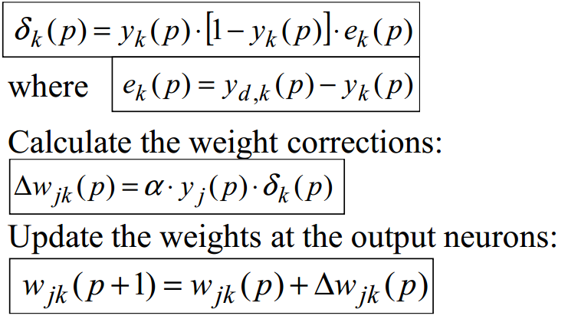
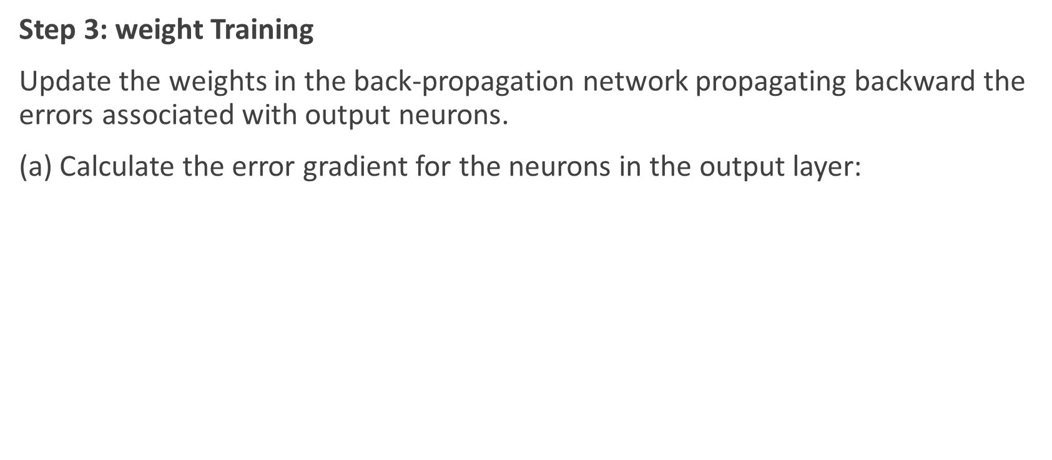
Back Propagation Training Algorithm
Step 3: weight Training
Update the weights in the back-propagation network propagating backward the errors associated with output neurons.
(a) Calculate the error gradient for the neurons in the output layer:

Slide 35
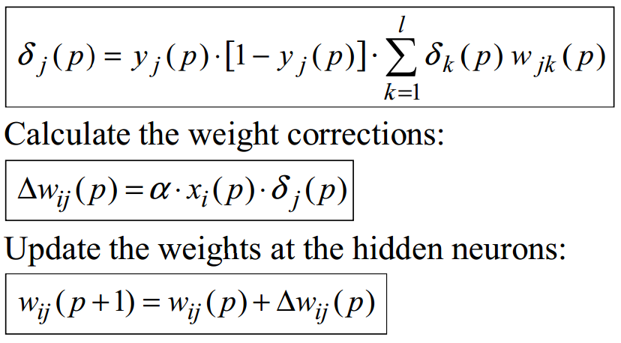
Back Propagation Training Algorithm
Step 3: weight Training(contd…)
(b) Calculate the error gradient for the neurons in the hidden layer:

Slide 36
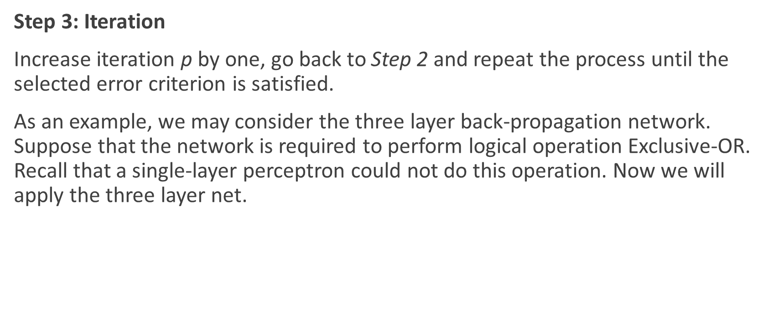
Back Propagation Training Algorithm
Step 3: Iteration
Increase iteration p by one, go back to Step 2 and repeat the process until the selected error criterion is satisfied.
As an example, we may consider the three layer back-propagation network. Suppose that the network is required to perform logical operation Exclusive-OR. Recall that a single-layer perceptron could not do this operation. Now we will apply the three layer net.

Slide 37
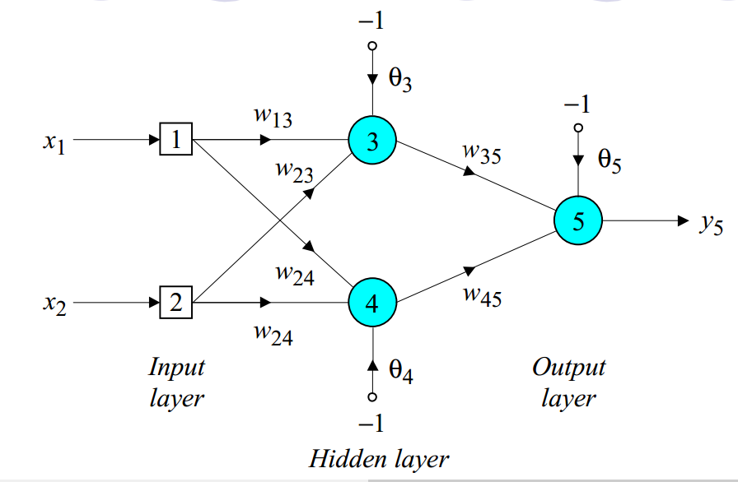
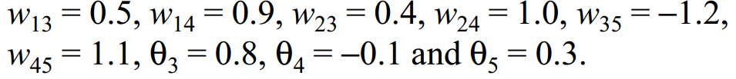
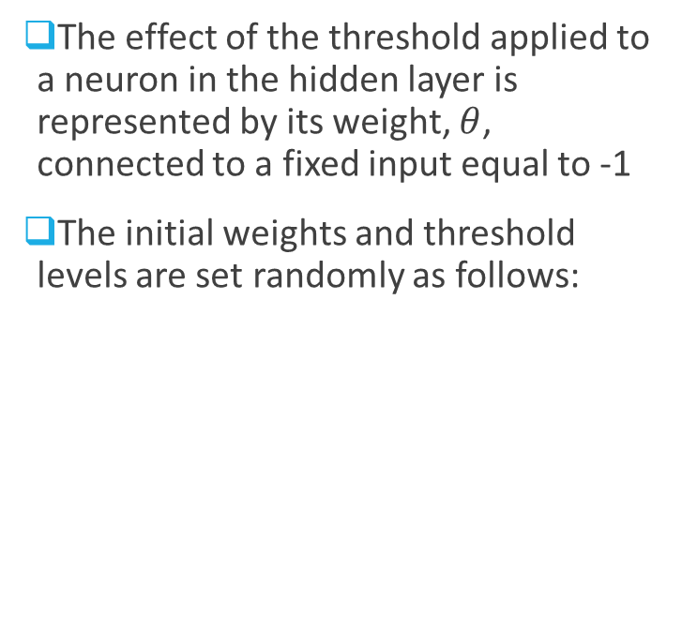

Example: Three-layer network for solving the Exclusive-OR operation
The effect of the threshold applied to a neuron in the hidden layer is represented by its weight, $θ$, connected to a fixed input equal to -1
The initial weights and threshold levels are set randomly as follows:
$$w_{14}$$

Slide 38
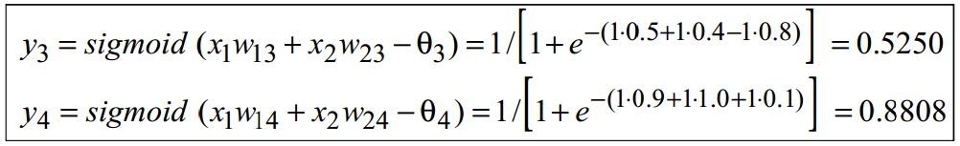

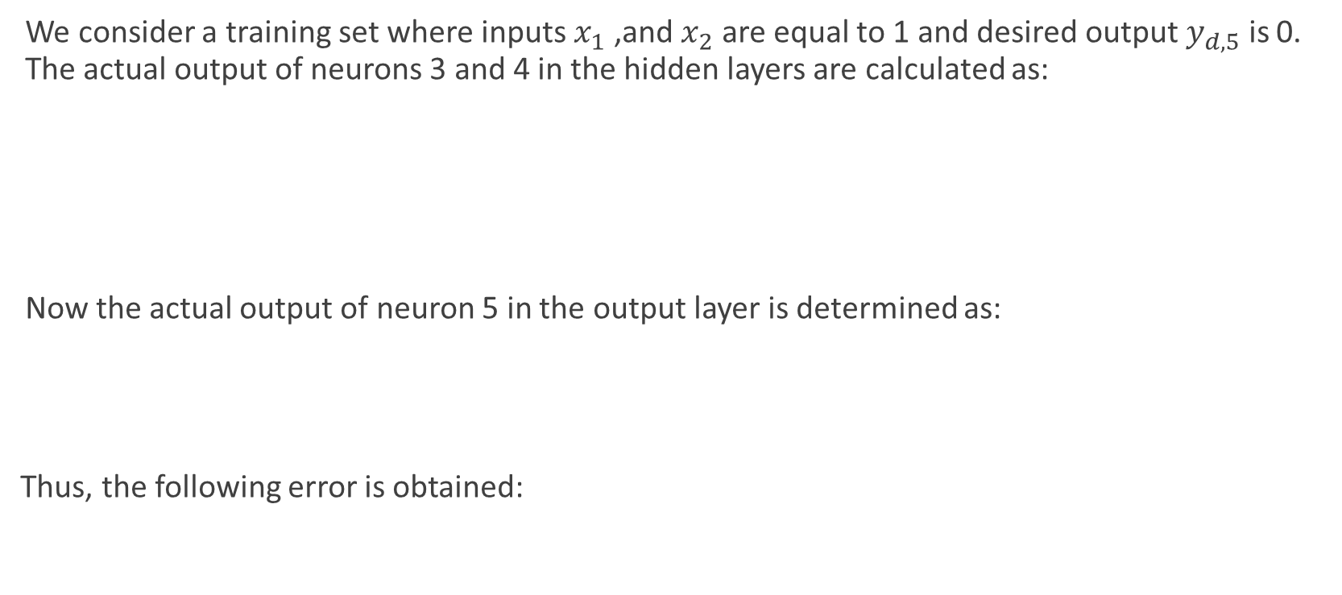
Example: Three-layer network for solving the Exclusive-OR operation
We consider a training set where inputs $x_{1}$ ,and $x_{2}$ are equal to 1 and desired output $y_{d,5}$ is 0. The actual output of neurons 3 and 4 in the hidden layers are calculated as:
Now the actual output of neuron 5 in the output layer is determined as:
Thus, the following error is obtained:

Slide 39
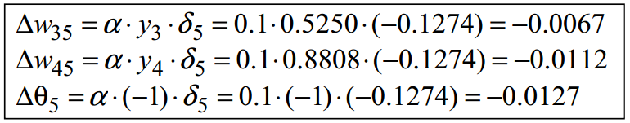
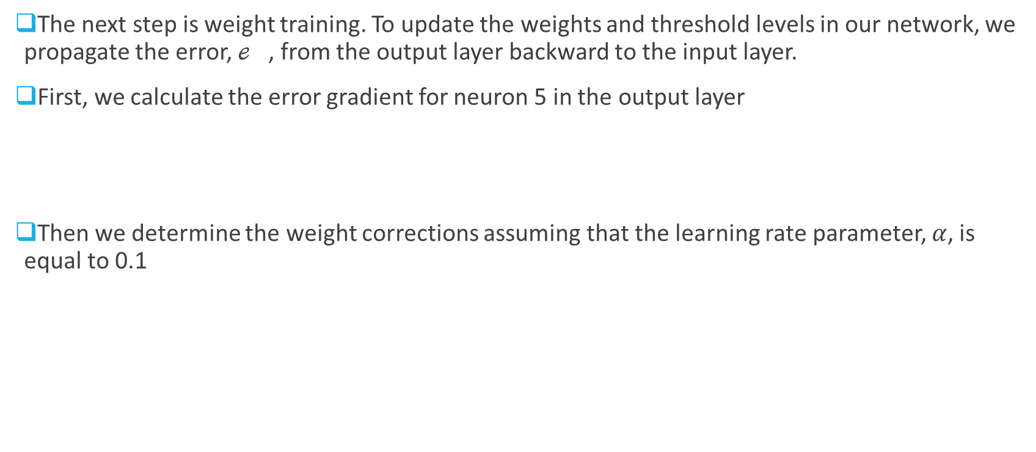
Example: Three-layer network for solving the Exclusive-OR operation
The next step is weight training. To update the weights and threshold levels in our network, we propagate the error, $ℯ_{}$, from the output layer backward to the input layer.
First, we calculate the error gradient for neuron 5 in the output layer
Then we determine the weight corrections assuming that the learning rate parameter, $α$, is equal to 0.1

Slide 40
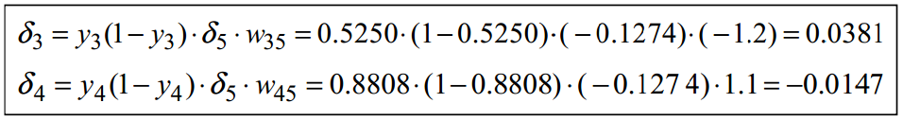
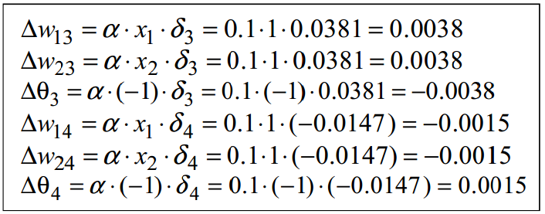
Example: Three-layer network for solving the Exclusive-OR operation
Now we calculate the error gradients for neuron 3 and 4 in the hidden layer:
We, then, determine the weight corrections:

Slide 41
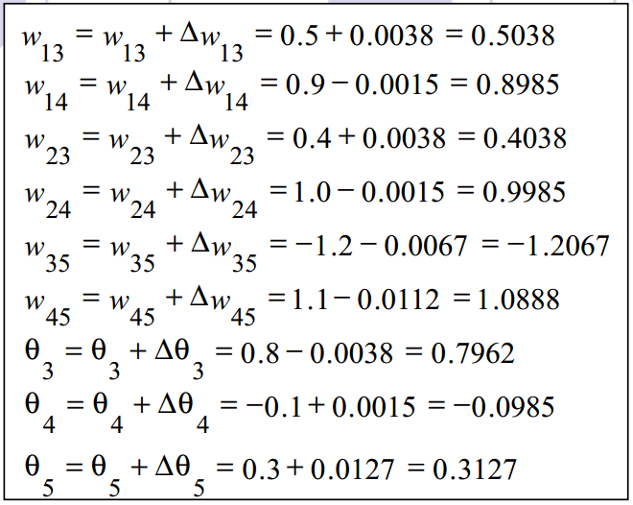
Example: Three-layer network for solving the Exclusive-OR operation
At last, we update all weights and thresholds
The training process is updated till the sum of squared error is less than 0.001

Slide 42
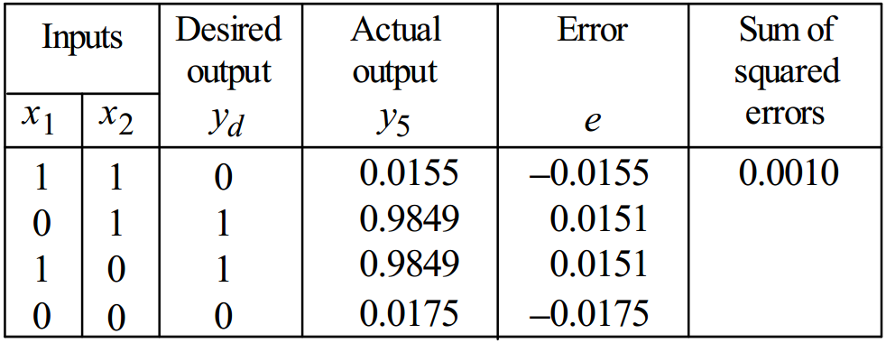
Example: Three-layer network for solving the Exclusive-OR operation
The Final results of three layer network learning is:

Slide 43
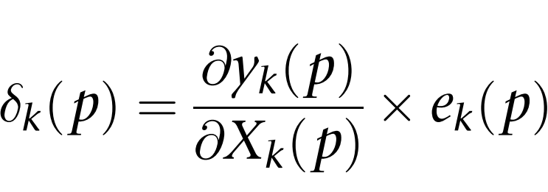
Gradient Descent
Gradient descent is an iterative minimisation method. The gradient of the error function always shows in the direction of the steepest ascent of the error function.
It is determined as the derivative of the activation function multiplied by the error at the neuron output
For Neuron k in the output layer
Where, yk(p) is the output of neuron k at iteration p, and Xk(p) is the net weighted input of neuron k at same iteration.

Slide 44
Characteristics of ANN
Adaptive learning
Self-organization
Error tolerance
Real-time operation
Parallel information processing

Slide 45
Benefits and Limitations of ANN
Benefits | Limitations
Ability to tackle new kind of problems | Performs less well at tasks humans tend to find difficult
Robustness | Lack of explanation facilities
 | Require large amount of test data

